Slide 1
Leasing Policy and Guidance Resulting from the PACT Act
January 2023
WORKING DRAFT January 26, 2023

Slide 2
Table of Contents
Presentation Purpose
PACT Act of 2022
Leasing-Specific PACT Act Provisions Overview
PACT Act Provisions with Real Property Implications Summary
PACT Act Section 702 – Major Lease Authorizations
PACT Act Section 703 – Changes to Prospectus Threshold and Congressional Action Requirements
PACT Act Section 704 – Sole Source Leasing from Academic Affiliates
PACT Act Section 706 – Authority for Joint Leasing Actions for DoD and VA
Appendices:
  Appendix A: Templates
  Appendix B: Lease Definitions
  Appendix C: Frequently Asked Questions
  Appendix D: Backup Material
Notes:
Talking Points:
As can be seen, we will walk through the PACT Act’s leasing-specific policy and process changes for each section, providing forms, definitions, and the start of our Frequently Asked Questions with answers.

Slide 3
Presentation Purpose
A Purpose:
Provide leasing-specific policy and guidance resulting from the PACT Act, enacted August 10, 2022, Public Law # 117-168
B Goals:
Provide information to VA leasing stakeholders including:
    RPO and NCO Leadership
    Lease Contracting Officers
    Leasing Specialists
    VAMC and VISN Leadership
    Capital Asset Managers
    Capital Planners
    VACO: OCAMS, OAEM, OGC
Describe process and policy changes for PACT-Act specific lease authorities*
*Guidance regarding Enhanced Use Lease requirements to be provided separately by OAEM.
Notes:
Talking Points:
The purpose of this briefing is to ensure these impacted by the PACT Act leasing-specific authorities have the details necessary to effectuate lease contracts respective to these changes.

Slide 4
PACT Act of 2022
The Honoring our Promise to Address Comprehensive Toxics (PACT) Act of 2022¹ significantly broadens access to health care, including enhancements to VA's real property leasing process, and benefits through expanded presumption of service-connected conditions and provides additional research and resources related to Veterans exposed to toxic substances during military service.
Sections 702-707 of the Act provides resourcing to enable and fund leases and other agreements to accomplish VA’s mission. These resources include:
Authorization of pending leases and streamlined leasing approvals
Enhanced authority to enter into non-competitive leases with Academic Affiliates
Funding for leases and Enhanced-Use Leases
¹Public Law # 117-168 enacted August 10, 2022
Notes:
Talking Points:
On August 10, 2022, Honoring our Promise to Address Comprehensive Toxics (PACT) Act of 2022 was enacted. The primary focus is to broaden access to healthcare and benefits for Veterans exposed to toxic substances.
This law also included changes to VA’s authorities specific to significantly enhance VA’s Leasing and Enhanced Use Leasing programs as can be seen by Sections 702 – 707. This briefing excludes the Enhanced Use Leasing changes, since that program is managed by VA’s Office of Management’s Office of Asset and Enterprise Management.
The increase in the prospectus threshold allows Major Leases (leases less than Prospectus Level Leases but exceeding $1M in net average annual rent) to proceed into execution with GSA delegation. In addition, the academic affiliate authority now allows VA to skip competition when leasing space with an approved academic affiliate.

Slide 5
Leasing-Specific PACT Act Provisions Overview
PACT Act provides VA new or expanded tools including:
Leasing
Lease of Space from Affiliates
VA/DoD Joint Facilities Leasing
Potential Benefits of PACT Act-Enhancements
Leasing Benefits | VA/DoD Joint Facilities Leasing Benefits
Raises threshold level and reduces administrative process* for Mid-Level and Major Level Leases** Allows for Sole Source leased space from Academic Affiliate upon appropriate approvals/acquisition process Provides certainty in annual approvals for VA Major Level Leases | Specifically authorizes leasing (in addition to planning, design, or construction) of a shared medical facility with DoD* Authorizes payment of VA lease costs in DoD facilities and deposit of DoD lease payments to VA
*SCIP and other approvals are still required
**Revised definitions included in Appendix B and Slide 9
What this means for you
Access to new capital solutions for more efficient lease execution and reduced timelines
Enhances productive working relationships with VA partners
Notes:
Talking Points:
We will go into more detail of each section in the following slides, but in general, the leasing-specific sections of the PACT Act change VA’s leasing authorities and requirements; allow for non-competitive lease contracts with approved academic affiliates; and allows VA and Department of Defense to fund co-located leases.
A lot of these leasing enhancements have been trying to become changes to VA’s authorizations for a few years. Thankfully, Congress was able to add these to the PACT Act in an overall effort to get Veterans access to care soonest.

Slide 6
PACT Act Provisions with Real Property Implication Summary
Section | Section Title | Type | Section Summary
Sec. 702 | Authorization of major medical facility leases of Department of Veterans Affairs for fiscal year 2023 | Leasing | Authorizes 31 VA leases and authorizes appropriations of $998.14M for these leases
Sec. 703 | Treatment of major medical facility leases of the Department of Veterans Affairs | Leasing | Changes Congressional lease authorization requirement from legislation to resolution Raises dollar threshold for Major Lease to GSA’s prospectus threshold
Sec. 704 | Authority to enter into agreements with academic affiliates and other entities to acquire space for the purpose of providing health-care resources to Veterans | Lease of Space from Affiliates | Authorizes Secretary to enter into leases with academic affiliates to acquire space for the purpose of providing health-care resources to Veterans notwithstanding competitive procedures (i.e., sole source) Includes “space” (room, unit, floor, wing, building, parking facility, etc.) owned or controlled by academic affiliate Space controlled by affiliate may include space owned by a State, local, municipal government, public or nonprofit agency, or other institution the Secretary considers appropriate
Sec. 705 | Modifications to enhanced-use lease authority of Department of Veterans Affairs | Expanded EUL Authority | Expands VA’s EUL authority to uses that either directly or indirectly benefit Veterans or provide supportive housing (current authority limited to only supportive housing); Appropriates $922M for entering into EULs
Sec. 706 | Authority for joint leasing actions of Department of Defense and Department of Veterans Affairs | VA/DoD Joint Sharing | Specifically authorizes lease of a shared medical facility (in addition to previous authority for planning, design, or construction of shared facility) up to, but not to exceed GSA's prospectus threshold, which is currently $3.613M in net average annual rent. Authorizes “Medical Facilities” account payment of VA lease costs in DoD facilities and deposit of DoD lease payments to VA
Sec. 707 | Appropriation of amounts for major medical facility leases | Leasing | Appropriates $1.88B for the 31 newly-authorized leases (section 703) to remain available until expended Appropriates $3.63B over 8 years (2024-2031) for 31 newly-authorized leases, or other approved leases to remain available
Notes:
Talking Points:
This slides summarizes the real property related PACT Act authorization changes. The next few slides will go into more details for all of these except for the Enhanced Use Lease (EUL) Section, Section 705, and the Appropriations Section, Section 707.
As I stated previously, the EUL program is managed by OM’s OAEM. They will be providing additional guidance on these changes.
Section 707 invests $5.5B in major medical facility leases over a 9-year period. Starts with $1.88B for the 31 Major Leases authorized in Section 702 to fund the Tenant Improvements and first year rent. Then for the next 8 years, it provides appropriations in addition to VHA’s Medical Facilities Lease Line Item to fund future rent for these 31 Major Leases and new lease requirements. These funds are managed by VHA Central Office’s Healthcare Engineering and Facilities Planning (HEFP) Office’s Lease Program Manager.

Slide 7
PACT Act Section 702 – Authorizations
Authorization Of Major Medical Facility Leases Of Department Of Veterans Affairs For Fiscal Year 2023
This section grants the Secretary of VA the authority to expend $998,137,000 of appropriated funds from the Medical Facilities account to carry out these 31 Major Level Medical Facility Leases. These leases will be executed by CFM ORP.
Notes:
Talking Points:
PACT Act Section 702 authorizes 31 Major Leases that were included in VA’s FY2023 Budget Request.
Prior VA authorization language required Congress to specifically authorize leases with an annual unserviced rent greater than $1M, aka, Major Leases. This authorization requirement caused issues with VA’s Budget Scoring, so Major Leases were removed from VA’s Budget to allow the budget to be finalized. Due to this, unfortunately, VA did not receive authorization for our leases since August 2017; four of these leases were originally submitted in VA’s FY2019 Budget Request. With the lack of authorization each year, each annual VA Budget Request’s Major Lease requests were rolled into the subsequent year until now where we have 31 Major Leases that were finally authorized.
These Leases are being executed by Office of Construction and Facilities Management (CFM) Office of Real Property’s (ORP) Lease Execution team.

Slide 8



PACT Act Section 703 – Leasing Changes
Overview
Changes Congressional authorization to Committee Resolutions for Major Level Leases by VA’s Senate Veterans Affairs and House Veterans Affairs and GSA’s House Transportation & Infrastructure and Senate Environment & Public Works.
Increases VA’s lease prospectus threshold to align with GSA’s lease prospectus threshold, which is currently $3.613M.
Allows interim leasing actions for Major Level Leases may be completed when deemed necessary
Authorizes the inclusion of a purchase option for a Major Level Lease.
VA Policy Changes
VA Process Changes
Definitions for Mid-Level Lease has been created and Major Lease has been updated to align with GSA's prospectus threshold, which is currently $3.613M in annual unserviced rent (net average annual rent for the term of the lease, including option periods and excluding the cost of services).
Full definitions are included in Appendix B and will be included in Lease Directive 7815 and VA Supplement to GSA’s Leasing Desk Guide.
Major Leases and Mid-Level Lease packages should be sent to CFM ORP per current “Submitting a Request for Land and Lease Actions” policy.
Only Major Level SCIP-approved-Leases will be included in VA’s annual Budget Request for VA and GSA Committees to provide Resolutions.
Major Lease and Mid-Level Lease expansions require consultation with ORP and OGC.
Interim Leasing Actions - Authorizes VA to execute interim leasing actions, such as lease extensions and succeeding leases, when a prospectus for a replacement lease has been submitted to Congress.
Purchase options - Requirements for inclusion of purchase option in Major Level Lease:
  Additional guidance forthcoming.
What this means for you
CFM ORP will execute Major and Mid-Level Leases.
Mid-Level Leases up to the prospectus threshold can proceed upon SCIP approval, GSA delegation, and funding approval.
Ensures annual approvals for VA Major Level Leases.
Notes:
Talking Points:
PACT Act Section 703 has a lot of significant changes, which is why a lot of information is on this slide.
As noted earlier, prior to the PACT Act, a lease above $1M in annual unserviced rent (aka Major Leases) required specific Congressional authorization in law. With the PACT Act, future leases greater than GSA’s prospectus threshold will now require VA’s Senate Veterans Affairs and House Veterans Affairs Committee Resolutions in addition to the normal GSA Committees resolutions. This will ensure a continued annual cycle of approvals for Major Leases.
The second key element that got changed with this section is the increase of the VA’s Major Lease threshold. It used to be over $1M in annual unserviced rent, now it mirrors GSA’s prospectus threshold, which is currently $3.613M. VA will be defining leases over $1M as Mid-Level Leases and Major Level Lease definition has been updated for those leases equal to or greater than GSA’s prospectus threshold. Minor Lease definition remains the same. These definitions are detailed in Appendix B.
Annual prospectus thresholds can be found at Annual prospectus thresholds | GSA or OMB Circular A-11 Appendix B.
Please note: CFM ORP will continue to execute all Major Leases and Mid-Level Leases. The guidance to seek CFM ORP’s assistance for Major Leases can be found in CFM’s current “Submitting a Request for Land and Lease Actions” policy. This policy will be updated to note that upon Strategic Capital Investment Planning (SCIP) and funding confirmation, CFM ORP can begin executing your Mid-Level Leases. Major Level Leases will still require an annual budget submission. Upon VA’s Budget Request submission, CFM ORP will automatically start as much upfront work as possible prior to VA and GSA’s Committees Resolutions.
NOTE: In the event proposals received in response to a minor lease procurement exceeds the $1M net average annual rent during the course of the procurement, the NCO can continue on with the procurement.
Finally, two additional elements were added to VA’s law:
1.) For Major Level Leases, VA now has interim leasing authority, which allows us to obtain GSA’s delegation for an interim lease will waiting for VA and GSA’s Committees Resolutions; and
2.) VA can add a purchase option into a Major Level Lease. The lease’s SCIP Business Case must include the option as part of the approval process, and the lease must score as operating. We’re still working guidance for this purchase option, so more to come.

Slide 9
PACT Act Section 703 Codified in VA’s Authorization
38 USC §8104. Congressional approval of certain medical facility acquisitions:
(a)(2)(B) No funds may be appropriated for any fiscal year, and the Secretary may not obligate or expend funds (other than for advance planning and design), for any major medical facility lease unless the Committee on Veterans' Affairs of the Senate and the Committee on Veterans' Affairs of the House of Representatives each adopt a resolution approving the lease.
(a)(3)(B)(i) The term "major medical facility lease"- means a lease for space for use as a new medical facility approved through the General Services Administration under section 3307(a) of title 40 at an average annual rent equal to or greater than the appropriate dollar threshold described in such section, which shall be subject to annual adjustment in accordance with section 3307(h) of such title;
Notes:
Talking Points:
The above language are the authorization updates within 38 USC § 8104. This should be used for future reference rather than the PACT Act.
RPLG summarized these changes as - pursuant to 38 U.S.C. § 8104, VA must obtain resolutions from the Committee on Veterans' Affairs of the Senate and the Committee on Veterans' Affairs of the House of Representatives approving any lease for use as a new medical facility where the average annual rent is equal to or greater than the threshold described in 40 U.S.C. § 3307(a).

Slide 10
PACT Act Section 703 Codified in VA’s Authorization (cont.)
38 USC §8104. Congressional approval of certain medical facility acquisitions:
(i)(1) Notwithstanding subsection (a)(2)(B), the Secretary may carry out interim leasing actions as the Secretary considers necessary for the following leases:
(A) Major medical facility leases (as defined in subsection (a)(3)(B)) approved pursuant to this section and for which a prospectus for a replacement lease has been submitted to Congress pursuant to subsection (b)(2).
(B) Replacement leases that do not require approval under this section and for which a prospectus has been submitted to Congress pursuant to subsection (b)(2).
(j) The Secretary may obligate and expend funds to exercise a purchase option included in any major medical facility lease (as defined in subsection (a)(3)(B)).
Notes:
Talking Points:
The above language are the authorization updates within 38 USC § 8104. This should be used for future reference rather than the PACT Act.

Slide 11
PACT Act Section 704 – Academic Affiliates
Overview
Expands 38 USC 8103 to allow explicit authority to lease from academic affiliates or covered entities.
VA Policy Changes
VA Process Changes
Allows VA to sole source with approved academic affiliates or covered entities rather than seeking competition.
To be included in Lease Directive 7815 and CFM ORP’s updated VA’s Supplement to GSA’s Leasing Desk Guide.
CFM created the attached JOTFOC template for use with approved academic affiliate leases above the SLAT. Guidance is included in the template.
CFM updated the attached Lack of Competition template for use with approved academic affiliate leases at or below the SLAT.
What this means for you
This is still a lease contract. Every requirement for a lease still exists, except for competition for space with an academic affiliate –
  Identify need based on projected workload
  Assess capital solutions to meet this need
  If lease is pursued, follow SCIP guidance. Out of cycle leases can be submitted
  Upon SCIP approval, technical requirements must be given to the Lease Contracting Officer
  If an approved academic affiliate or covered entity has space that meets VA’s needs, a noncompetitive lease may be pursued if determined in the best interest of the VA
  If an approved academic affiliate or covered entity does not have space that meets VA’s needs, competition must be sought, including compliance with the VA Rule of Two
Notes:
Talking Points:
Section 704 allows VA to enter into sole source contracts directly with approved academic affiliates or their covered entity for the purpose of providing health-care resources to Veterans.
These are still leases. The only change to the current lease process is that for approved academic affiliates or their covered entity, VA does not have to seek competition if the academic affiliate is an approved affiliate, which is determined by VHA’s Office of Academic Affairs; their proposal is in the best interest of the VA; and they can meet VA’s technical requirements. All leases still require development of requirements, SCIP approvals, delegation from GSA, physical security and seismic requirements, comparable in the market, and for Major Level Leases, approvals through VA’s Committees Resolutions and GSA’s Committees Resolutions.
If the academic affiliate is not an approved affiliate, or if their proposal is not comparable to the market or does not meet VA’s technical requirements, the lease must be procured through the normal competitive process, which includes VA Rule of Two.
Appendix A includes a CFM ORP JOTFOC template for academic affiliate leases above the SLAT and an updated Lack of Competition Memo to File for academic affiliate leases at or below the SLAT.
Note: The PACT Act incorrectly referenced 10 USC 2304 but should have referenced 41 USC 3301. Title 10 does not apply to VA and only applies to DoD. VA is seeking correction; however, that incorrect reference does not impact VA’s ability to lease to academic affiliates without competition.

Slide 12


Section 704 Sole Source Lease from Affiliate
Requirements Process
1. Need Identification, Defined Technical Project Requirements
(Implementation Planning)
2. SCIP submittal, inclusion in VA Budget
SCIP & Budget Process
Acquisition Process
5. GSA delegation and Congressional Prospectus (if required)
3. Market research
4. Determination
6. Lease
Gauge opportunities to meet VA technical requirements
Determine course of action
Sole Source from Affiliate
OR
Lease Competition*
*VA Rule of Two Required
Notes:
Talking Points:
This flow diagram provides a pictorial for a typical lease. The lease starts with a space need based on projected workload demand; submission and approval through SCIP, out-of-cycles are allowed; for Major Level Leases, budget submission and VA and GSA’s Committees Resolutions; GSA delegation; market research to meet VA’s lease requirements, which includes discussions with the academic affiliate; determination if the sole source by the approved academic affiliate is acceptable, and the awards the lease.
The only difference in the lease process for approved academic affiliates is that at the Determination stage, if the academic affiliate is an approved affiliate, has a rate that is comparable to the market, and can meet VA’s technical requirements, a sole source lease contract can be executed. If not, the lease must be competitively procured following VA Rule of Two requirements.

Slide 13
PACT Act Section 704 Codified in VA’s Authorization
38 USC §8103. Authority to construct and alter, and to acquire sites for, medical facilities
(h)(1) Notwithstanding any other provision of law requiring the use of competitive procedures, including section 2304 of title 10, when the Secretary determines it to be in the best interest of the Department, the Secretary may enter into a lease with an academic affiliate or covered entity to acquire space for the purpose of providing health-care resources to veterans.
(2) In this subsection:
(A) The term "academic affiliate" means an institution or organization described in section 7302(d) of this title.
(B) The term "covered entity" means a unit or subdivision of a State, local, or municipal government, public or nonprofit agency, institution, or organization, or other institution or organization as the Secretary considers appropriate that owns property controlled by an academic affiliate to be leased under this subsection.
(C) The term "health-care resource" has the meaning given that term in section 8152(1) of this title.
(D) The term "space" means any room, unit, floor, wing, building, parking facility, or other subdivision of a building or facility owned or controlled by an academic affiliate.
Notes:
Talking Points:
The above language are the authorization updates within 38 USC § 8103. This should be used for future reference rather than the PACT Act.

Slide 14
PACT Act Section 706 – Authority for Joint Leasing Actions of DoD and VA
Overview
Expands DoD’s authority to enter into agreements with VA for planning, design, and construction of shared medical facilities to include leasing of facilities, transfer of funds for leasing, and to keep and use funds for shared medical facility leases.
Expands VA authority to enter into agreement with DoD for planning, design, and construction of shared medical facility leases.
VA’s portion of the estimated lease costs must be less than VA’s prospectus threshold.
VA Policy Changes
VA Process Changes
To be included in Lease Directive 7815 and our updated VA’s Supplement to GSA’s Leasing Desk Guide.
VA can pay for planning, design, and construction for shared medical facility leases.
What this means for you
VA and DoD can collaborate more effectively, since funds can be exchanged
SCIP approval is required for VA portion of space regardless of the lead agency
If VA is the lead agency for the lease procurement, GSA delegation is required
Upon appropriate approvals, VA/DoD joint medical facility leases may be solicited on a competitive basis
If VA is lead agency for competition, compliance with the VA Rule of Two applies
Notes:
Talking Points:
Section 706 enables VA and DoD to enter into a shared lease for a new medical facility.
Primary aspects is that it allows both parties to transfer funds to reimburse each other for planning and other costs.

Slide 15
PACT Act Section 706 Codified in VA’s Authorization
38 USC §8111B. Shared medical facilities with Department of Defense
(b)(3) The Secretary of Veterans Affairs may transfer to the Department of Defense amounts appropriated to the ‘Medical Facilities’ account of the Department of Veterans Affairs for the purpose of leasing space for a shared medical facility if the estimated share of the Department of Veterans Affairs for the lease costs does not exceed the amount specified in section 8104(a)(3)(B) of this title.;
(c) (3) Any amount transferred to the Secretary of Veterans Affairs by the Secretary of Defense for the purpose of leasing space for a shared medical facility may be credited to the ‘Medical Facilities’ account of the Department of Veterans Affairs and may be used for such purpose.
Notes:
Talking Points:
The above language is the added authority within 38 USC § 8111B. This should be used for future reference rather than the PACT Act.

Slide 16
APPENDIX A
Templates
Justification for Other than Full and Open Competition
Lack of Competition – Memo to File (SLAT Level Leases)

Slide 17
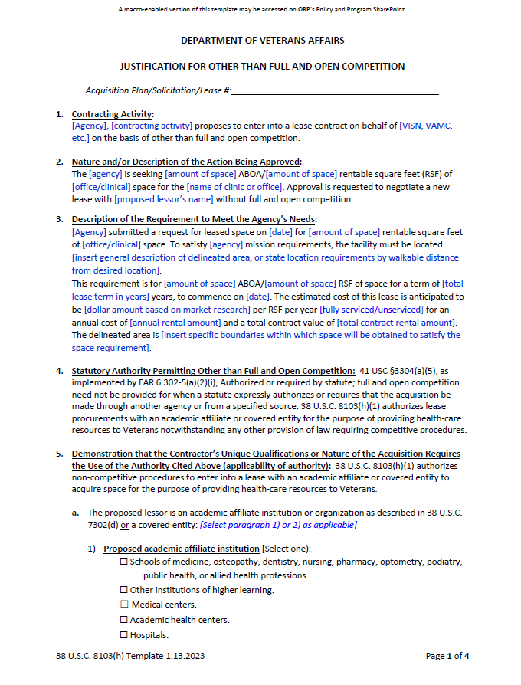
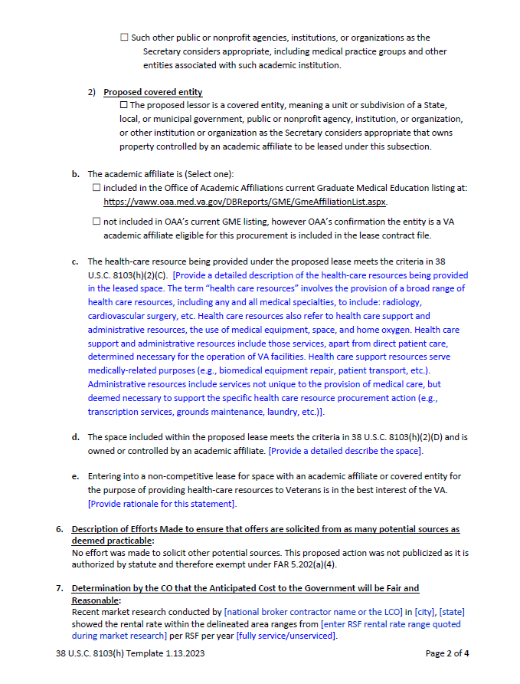
Justification for Other Than Full and Open Competition
Notes:
Talking Points:
(Walk through JOTFOC)
This is accessible on CFM ORP’s intranet, SharePoint site and OAEM’s Electronic Lease Management Tool (ELMT.)

Slide 18
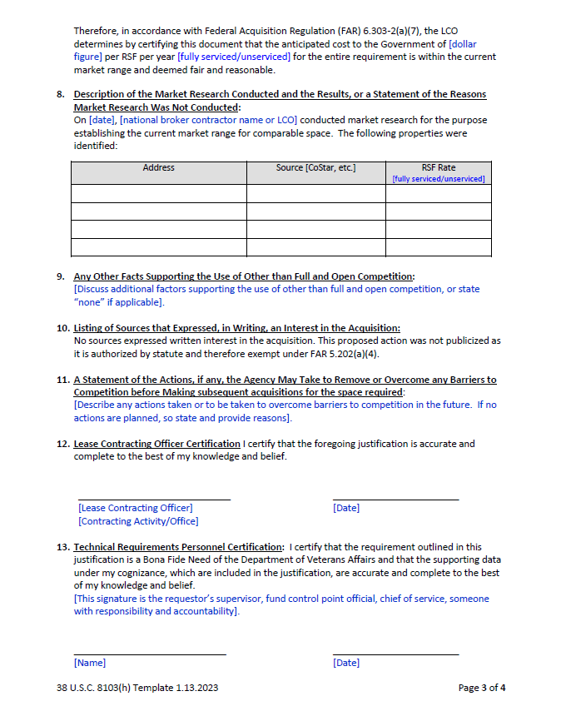
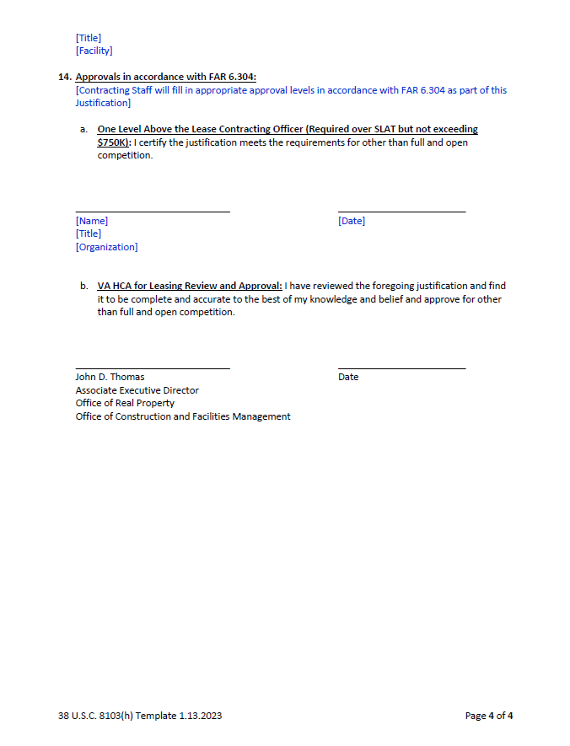
Justification for Other Than Full and Open Competition (continued)

Slide 19
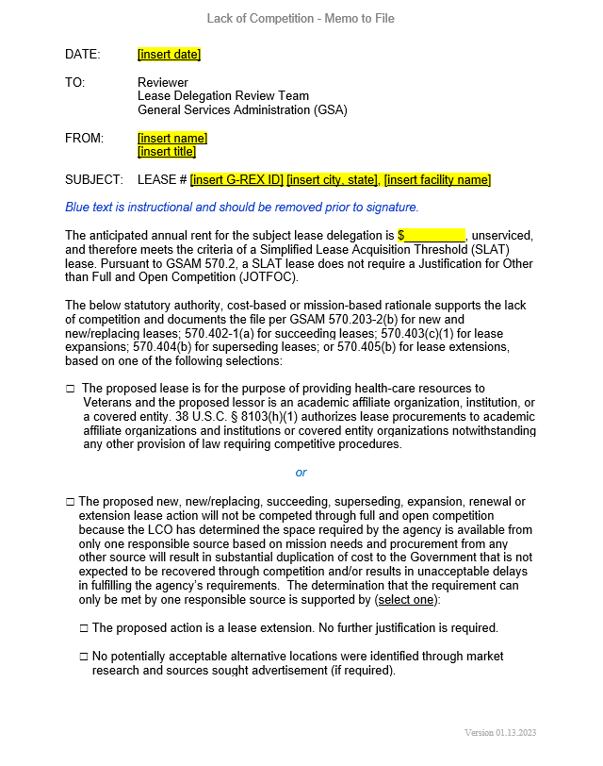
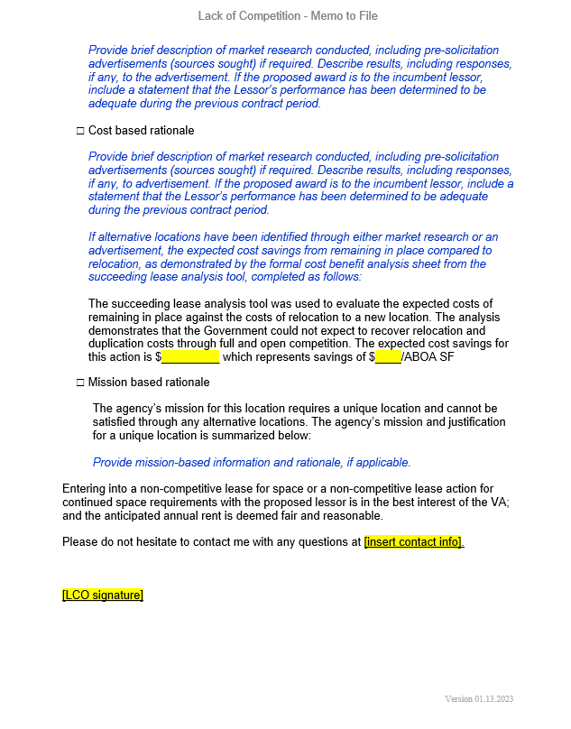
Lack of Competition – Memo to File (SLAT level leases)
Notes:
Talking Points:
(Walk through memo)
This is accessible on CFM ORP’s intranet, SharePoint site and OAEM’s Electronic Lease Management Tool (ELMT.)

Slide 20
APPENDIX B
Lease Definitions

Slide 21
Definitions
Major Level Lease: The term “major lease” or “major level lease” means the net average annual rent for the term of the lease (including option periods and excluding the cost of services) is equal to or greater than the prospectus level threshold amount for the fiscal year in which award is to be made, requiring the prior submission and approval of a prospectus. The prospectus threshold for VA is the “major medical facility lease threshold” as defined in 38 U.S.C. § 8104(a)(3)(B), excluding the cost of services.
Mid-Level Lease: The term “mid-level lease” means leases exceeding $1,000,000 in annual unserviced rent (net average annual rent for the term of the lease, including option periods and excluding the cost of services) but less than the major level lease threshold.
Minor Lease: The term “minor lease” or “minor level lease” means leases of $1,000,000 or less in annual unserviced rent (net average annual rent for the term of the lease, including option periods and excluding the cost of services).
Notes:
Talking Points:
These are VA’s new lease definitions starting immediately. They will be included in VA’s real property policies.

Slide 22
APPENDIX C
Frequently Asked Questions

Slide 23
Frequently Asked Questions
A Space Requirements:
Q: Does an academic affiliate or VA-DoD lease for new space need to go through SCIP?
A: Yes, the standard process, including SCIP and GSA delegation, is required for all leases, regardless of size.
Q: What should I do if the affiliate or DoD has less space than the requirement?
A: The affiliate or DoD must meet the agency’s minimum requirements, otherwise the lease must be competed.
Q: What should I do if the affiliate or DoD has more space than the requirement?
A: The government is prohibited from leasing space in excess of the space requirement.
Q: Will compliance with VA seismic requirements be required?
A: Yes, if compliance with VA Standards of Seismic Safety for Existing Federally Owned and Leased Buildings cannot be met, lease competition will be required.
Q: Will compliance with VA life safety/physical security be required?
A: Yes, if compliance with VA life safety/physical security cannot be met, either a lease competition will be required, or a waiver process must be pursued through VHA’s Physical Security Committee.
Notes:
Talking Points:
The next three slides provide questions we’ve received to date related to the leasing specific issues of the PACT Act. As additional questions are raised, we will add them as well. We will upload these to CFM ORP’s sharepoint site for additional reference.

Slide 24
Frequently Asked Questions
B Definitions:
Q: The PACT Act allows the Secretary to enter into a lease with a covered entity, what is included in “covered entity” definition?
A: The proposed lessor is a covered entity, meaning a unit or subdivision of a State, local, or municipal government, public or nonprofit agency, institution, or organization, or other institution or organization as the Secretary considers appropriate that owns property controlled by an academic affiliate to be leased under this subsection.
Q: Can VA acquire healthcare resources from the affiliate or share VA healthcare resources with DoD as part of the lease?
A: No. Sharing of healthcare resources with an affiliate under 38 U.S.C. § 8153 or with DoD under 38 U.S.C. § 8111 must be executed via separate contract(s).
Q: Can space at more than one location/ address with the same affiliate or DoD be included in the lease?
A: No. A separate SCIP and GSA delegation are required for each (individual) space lease.

Slide 25
Frequently Asked Questions
C Process:
Q: With the increase in prospectus threshold, will Field Leasing Contracting Officers execute leases between $1M and $3.613M in estimated average annual rent?
A: No. CFM ORP will continue to execute leases above estimated $1M in average annual rent.
Q: For leases below the Simplified Lease Acquisition Threshold (SLAT), are the SCIP approval, GSA delegation, market research, and acquisition package steps still required?
A: Yes. The standard process, including SCIP and GSA delegation, is required for all leases, including SLAT leases.
Q: Can a sole source lease be awarded if Academic Affiliate rental rates are determined not to be fair and reasonable?
A: No. If the proposed sole source rental rates are determined to not be fair and reasonable, a lease competition is required.
Q: Are there special forms that need to be completed for a sole source lease to an affiliate under the PACT Act?
A: Yes. Justification for sole source must be completed – Justification for Other than Full and Open Competition template is available from ORP and a sample is included in Appendix A of this presentation.
Q: If during market research for a SCIP approved Minor Lease, the results reflect anticipated annual unserviced rent greater than $1M, can a Network Contracting Office (NCO) Leasing Contracting Officer proceed with the solicitation?
A: No. Per VA policy, all Mid-Level Leases must be executed by CFM ORP. The only exception for NCOs executing Mid-Level Leases is if lease proposals are received that result in unserviced annual rent greater than $1M.

Slide 26
APPENDIX D
Backup Material

Slide 27
Leasing Elements of PACT Act
Section 703 – Treatment of Major Medical Facility Leases of the Department of Veterans Affairs
  Replaces Congressional authorization with Committee Resolutions from: Senate Veterans Affairs, House Veterans Affairs, House Transportation & Infrastructure (GSA), and Senate Environment & Public Works (GSA)
  Aligns prospectus level with GSA’s authority, currently equal to or greater than $3.613M average annual rent.
  Authorizes VA to execute interim leasing actions while seeking resolutions.
  Authorizes VA to include and exercise purchase options in major medical facility leases.
Section 704 - Authority To Enter Into Agreements With Academic Affiliates And Other Entities To Acquire Space For The Purpose Of Providing Health-care Resources To Veterans
  Expands 38 U.S.C. with explicit authority to lease from academic affiliates or covered entity for space to provide health-care.

Slide 28
Leasing Elements of PACT Act, cont.
Section 705. Modifications to Enhanced-Use Lease Authority of Department of Veterans Affairs.
  Allows the Secretary to enter an EUL so long as it not inconsistent with, nor adversely affect VA’s mission, or operation of facilities, programs, and services of the Department.
  Removed authority sunset
Section 706. Authority For Joint Leasing Actions Of Department Of Defense And Department Of Veterans Affairs
  Broadens existing DOD authority under 10 U.S.C. 1104a to enter into agreements with VA for the planning, design, and construction of shared medical facilities to include leasing of facilities, transfer of funds for leasing, and to keep and use funds for shared medical facility leases.
  Expands 38 U.S.C. 8111B to include entering into agreements with DOD for the planning, design, and construction for shared medical facility leases.
  Section 707. Appropriation Of Amounts For Major Medical Facility Leases.
  This Section appropriates $1,880,000,000 for major medical facility leases for FY2023. For subsequent years (FY2024 through FY2031), it provides for appropriations as well.

Slide 29


Sec. 704 - Scenario 1: Sole Source Lease from Affiliate for 7,000 RSF of Specialty Care Space for Eye Clinic (below Simplified Lease Acquisition Threshold)
Affiliate Responsibilities
Respond to market research⁴
Identify existing (or new) clinical space available within delineated area
Secure Financing (Private Capital)
Renovate (or build) space for VA use
Successful commissioning report (if required)
Provide (or contract for) Facility Management/ Operations pursuant to the terms of the lease
6
Negotiations With Identified Affiliate
1
2⁵
3⁵
4⁵
5⁵
8
9
7
VA Provides Direct Patient Care
Identified need for 7,000 rentable square feet of specialty care space for an Eye Clinic in local vicinity, submit for approvals¹
Review market research and identified affiliate space
Develop acquisition package for 7,000 RSF of Eye Clinic space (no healthcare resource sharing required)
Develop Lack of Competition Memo (SLAT) and Request for Lease Proposal for Affiliate submission ⁴
Complete internal VA approvals
Review RLP submission and confirm space meets seismic, physical security, ABAAS, and fire/life safety requirements
Negotiate Sole Source Lease Contract with Affiliate for Eye Clinic space^{2,3,4}
Activate, staff, and operate space³
(VA Pays Rent to Affiliate)
Conduct market research,
gauge potential courses of action; ⁴
VA Responsibilities
APPROVAL POINTS
¹ Requirements must be submitted by VHA through SCIP, be included in Budget Vol. IV (https://www.va.gov/budget/products.asp), and receive GSA delegation prior to proceeding with lease.
² Lack of Competition Memo must be completed (Template located on ORP SP and ELMT SP)
³ Any Healthcare Resource sharing must be executed separately through a contract under 38 USC 8153
⁴ Steps 2 through 5 represent contracting/procurement/acquisition process for the lease
= OGC
= VHA / VHA OAA
VHA USH,
VAOB, VAEB
= ORP/CFM
= OAEM
=
Notes:
Scenario Overview:
In this scenario VA leases Eye Clinic space directly from an affiliate under a sole source lease
Standard VA lease terms would apply including VA rent and tenant improvement as only funding sources
The affiliate could either construct the eye clinic space, or rehabilitate an existing building on land that they own or control
PACT Act Enabler
Enables sole source lease contract with affiliates, CFM ORP will continue to execute all leases above $1M in net average annual rent (Mid-Level Leases).
Notable restrictions:
Any healthcare/other sharing executed separately through a contract under 38 USC 8153
All leases need standard approvals - including SCIP and GSA delegation - prior to proceeding
Special justification for sole source must be completed – Lack of Competition memo (SLAT leases) available from ORP

Slide 30


Sec. 704 - Scenario 2: Sole Source Lease from Affiliate for New VA Patient Care Wing Co-Located with Affiliate’s Facility
Affiliate Responsibilities
Respond to market research⁵
Identify owned or controlled assets available to meet VA-defined technical project requirements
Secure Financing (Private Capital)
Renovate or construct new wing for VA use
Successful commissioning report
Provide (or contract for) Facility Management/ Operations pursuant to the terms of the lease
6
Negotiations With Identified Affiliate
1
2⁵
3⁵
4⁵
5⁵
VA Wing
8
9
Affiliate Hospital
Identify/Define VA facility need, submit for approvals¹
Define technical project requirements
7
Review market research to gauge opportunities to meet VA technical requirements
Develop acquisition package
Request for Lease Proposal for Affiliate submission^{3,5}
Conduct market research,
gauge potential courses of action⁵;
Complete Prospectus if required²
Complete internal VA approvals
Negotiate Sole Source Lease Contract with Affiliate to renovate or construct new wing in Affiliate hospital for VA use^{3,4,5}
Activate, staff, and operate space⁴
(VA Pays Rent to Affiliate)
VA Provides Direct Patient Care⁴
VA Responsibilities
APPROVAL POINTS
= OGC
= VHA / VHA OAA
¹ Requirements must be submitted by VHA through SCIP, be included in Budget Vol. IV (https://www.va.gov/budget/products.asp), and receive GSA delegation prior to proceeding with lease.
² Prospectus and Congressional Resolution required for all leases above GSA Prospectus threshold
³ JOTFOC must be completed according to policy (Template located on ORP SP and ELMT)
⁴ Any Healthcare Resource sharing must be executed separately through a contract t under 38 USC 8153
⁵ Steps 2 through 5 represent contracting/procurement/acquisition process for the lease
VHA USH,
VAOB, VAEB
= ORP/CFM
= OAEM
=
Notes:
Scenario Overview:
In this scenario VA leases a wing of hospital directly from an affiliate under a sole source lease
Standard VA lease terms would apply including VA rent and tenant improvement as only funding sources
This could be either a new wing or a floor of a facility that is either
newly constructed on land owned or controlled by affiliate, or
in an existing Affiliate owned/controlled building
Lease may be with a “covered entity” – defined by law as: “…a unit or subdivision of a State, local, or municipal government, public or nonprofit agency, institution, or organization, or other institution or organization as the Secretary considers appropriate that owns property controlled by an academic affiliate to be leased under this subsection.”
VA would provide all direct patient care (unless a sharing agreement contract were executed separately)
PACT Act Enabler
Enables sole source lease contracts with affiliates, CFM ORP will continue to execute all leases above $1M in net average annual rent (Mid-Level Leases).
Notable restrictions:
Any healthcare/other sharing executed separately through a contract under 38 USC 8153
All leases need standard approvals - including SCIP and GSA delegation - prior to proceeding
Still subject to prospectus thresholds for Major Level Leases equal to or greater than $3.613 million in annual rent
Special justification for sole source must be completed – Justification for Other than Full and Open Competition available from ORP

Slide 31
Sec. 706 – Scenario 3: Joint Leased VA/DoD Clinic
Private Sector (Developer) Responsibilities
Developers bid on joint lease solicitation
Selected Developer Constructs Clinic Facility for Joint VA/DoD Lease including successful commissioning report
(to meet negotiated VA & DoD design standards)
Developer provides for Facility Management/ Operations pursuant to terms of the lease
5
1
2
3
4
7
8
6
Identify/Define VA facility need, submit for approvals¹
Define technical project requirements
Coordinate with Capital Asset Planning Committee to gauge local DoD facility needs¹
VA/DoD jointly create concept of operations⁶ and budget for jointly-occupied leased space^{1,2,3}
Designated “lead” agency (VA or DoD) issues solicitation for lease via competitive bid^{4,5,6}
Provide Direct Patient Care²
(VA staff in VA space; DoD staff in DoD space)
Activate and Occupy Joint Clinic³
(Lead agency to pay rent to clinic owner, Non-Lead agency to reimburse Lead agency for Non-Lead Agency’s share of rent)²
Award / Lease execution
VA & DoD Responsibilities
APPROVAL POINTS
¹ Requirements must be submitted by VHA through SCIP, be included in Budget Vol. IV (https://www.va.gov/budget/products.asp), and receive GSA delegation prior to VA proceeding with lease
² Healthcare/other sharing must be executed separately through a contract under 38 USC 8111
³ PACT Act enhancements provide authority to transfer funds between agencies for cost reimbursement
⁴ Limited to individual agency limits, for VA, avg annual rent must be below prospectus limit
⁵ If VA is the lead agency for lease competition, compliance with the VA Rule of Two is required
⁶ Including project development plan, space/equipment plan, sharing of resources
= OGC
= VHA
= ORP/CFM
= DoD/JEC Info Briefing
Notes:
Scenario Overview:
In this scenario VA and DoD jointly lease a medical clinic for joint operations to meet identified VA and DoD needs
VA and DoD jointly create a Concept of Operations that outlines sharing of resources and project development plan/designs that meet respective agency standards
VA would provide all patient care in the VA-portion of the space unless a DoD sharing agreement contract were executed separately
PACT Act Enablers
Enables joint facility leasing
Allows both parties to transfer funds to reimburse each other for cost reimbursement of planning and other costs
Notable restrictions:
Any healthcare/other sharing executed separately through a contract under 38 USC 8111
Facility needs must be submitted by VHA through the SCIP process and receive GSA delegation prior to VA proceeding with lease
VA portion of rent must be under the $3.613 million threshold

Slide 32
Links to Additional Resources
Agreement Type
Topic | Office
Office of Real Property Policy Intranet | Office of Real Property – Office of Construction & Facilities Management
Leasing (including Justifications for Other than Full and Open Competition, Simplified Lease Acquisition Threshold) Templates | Office of Construction and Facilities Management, Office of Real Property, Policy & Programs Service (003C7A)
Enhanced Use Lease (EUL) | Office of Asset Enterprise Management
Academic Affiliates and Sharing Agreements under 38 USC 8153 | VHA Medical Sharing/Affiliate National Program Office (MSO) Medical Sharing Office (MSO) SharePoint The National Center for Healthcare Advancement and Partnership (HAP) Office of Academic Affiliation (OAA)
VA/DoD Health Care Resource Sharing under 38 USC 8111 | VA/DoD Medical Sharing Office
Strategic Capital Investment Planning (SCIP) | Office of Asset Enterprise Management
Strategic Partnerships | Secretary’s Center for Strategic Partnership (SCSP)

