Slide 2
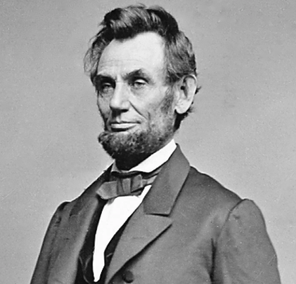
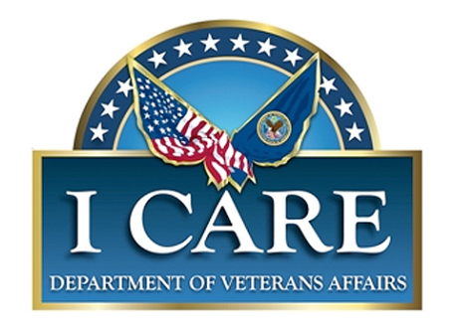
Office of Construction & Facilities Management (CFM)
VA Mission - To fulfill President Lincoln's promise, To fulfill President Lincoln's promise to care for those who have served in our nation’s military and for their families, caregivers, and survivors, by serving and honoring the men and women who are America’s Veterans.
CFM Mission - Advance VA’s mission in support of our Nation’s Veterans by planning, designing, constructing and acquiring major facilities, and setting design and construction standards.
Core Values - Integrity, Commitment, Advocacy, Respect, and Excellence (I CARE)

Slide 3
CFM Priorities
Focus on Speed and Agility
VA Facilities Strategy
Public Private Partnerships
Digital Transformation – leverage industry COTS products and of data analytics integrated facility lifecycle management cradle to grave
VA / USACE interoperability
Implementation of Design/Build project delivery methodology
Increase Industry Engagement – implement vendor management program
Improve Contract Administration/Project Delivery – improve cost, schedule, scope and quality management
Implement Strategic Acquisition Vehicles – category management
Partnering – process improvement with Interagency and Non-Departmental Federal Entity
This is where we are headed but we can use your good ideas!

Slide 4
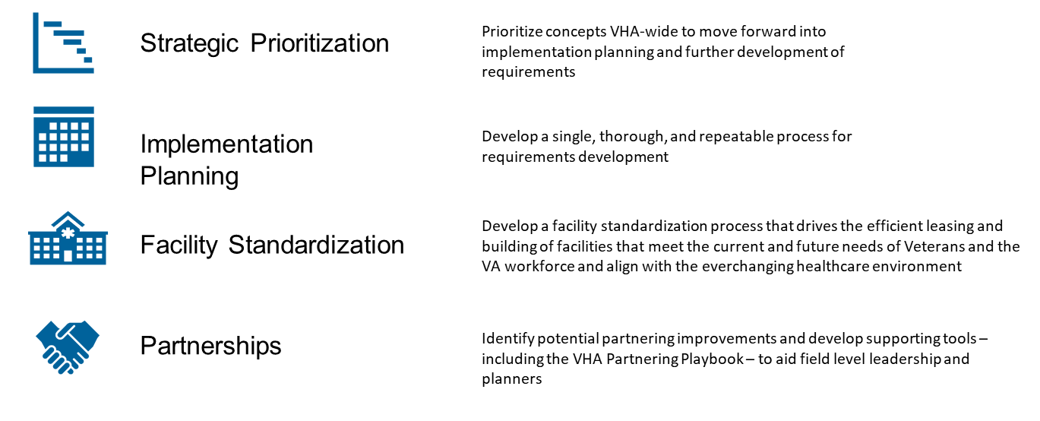
VA Facilities Strategy

Slide 5
Major Construction Pipeline
CFM is managing 98 projects in planning, design, and construction valued at $12B:
37 Veterans Health Administration (VHA) Major Construction healthcare projects valued at $8.4B
33 Seismic Projects valued at $2.9B
17 of the above projects are Super Construction projects (>$100M executed by the United States Army Corps of Engineers (USACE) valued at approximately $4.5B)
1 project is a CFM executed, Major Funded Chip-in Project at $221M
28 National Cemetery Administration (NCA) Major Construction projects valued over $904M
Data Source Used: CFMIS Data Date: 2/28/23

Slide 6
Operations Trends
Speed and Agility
Rigorous Change Management – reduce volatility in scope
Accelerate up decision cycles – if we must change, make it quick
Digital Transformation – new Project Management Information System
Increasing percentage of Super Construction projects
Joint PMO – VA / U.S. Army Corps of Engineers (USACE)
Increased Interoperability – information sharing and common operating picture

Slide 7
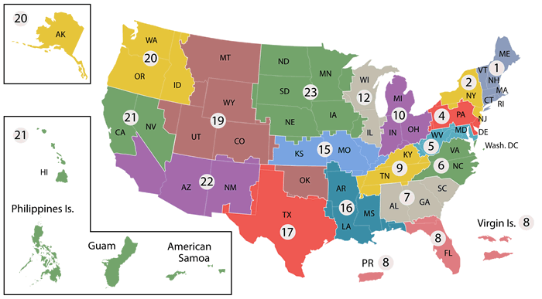
Regions
Central Region
Gurnee, IL
Western Region
Vallejo, CA
Eastern Region
Washington, DC

Slide 8
CFM Acquisition Program
Responsible for acquisition and administration of procurements:
Major construction,
Architect - Engineer (AE),
Support services – Construction Management, Lease Acquisition Support Services,
Supporting VHA, NCA, and VBA
FY22 $411M spend ($511M from FY22 Authorized by Public Law No: 117-190 on 10/10/2022).
Responsible for Major Construction Interagency Agreements
Assists with construction procurements for other organizations (Minor and Non-reoccurring Maintenance projects - under $20M)
Promotes competition for small businesses (including Veterans First Program) in major construction, design, and support services:
Over 70% of contract dollars awarded to SDVOSB/VOSBs in FY22
Including Several Major Construction Projects
d) Promote Diversity, Equity, and Inclusion - host Women Owned Small Business Industry Day

Slide 9
Acquisition Trends
Strategic Acquisition vehicles
Small Business engagement
Industry Days – Joint
Stipends
Union Labor Participation
Design Build and Alternative Delivery Methods
Integrated Financial Acquisition Management System (IFAMS) Implementation

Slide 10
Acquisition Initiatives
Award and administer contracts for Veterans Health Administration, Veteran Benefits Administration, and National Cemetery Administration for Major construction projects and support services
Interagency Agreement with Non-Departmental Federal Entity
Increase Industry Engagement
Seeking Feedback (Industry Days, Sources Sought, Targeted Outreach)
Partnering
Pathfinder – Vendor Management
Building capacity focused on speed and agility
Category Management/Strategic Acquisition Vehicles
2 - A/E (CRO & NRO) - FY23
Veteran Facility Transformation & Healthcare Enhancement (VFT&HE) - FY23
Land Acquisition Strategic Utilization BPA - FY23
Historical Preservation Technical Compliance BPA – FY23
Design Build – FY24
Feasibility Studies – FY24
2 A/E (WRO & ERO) - FY24
Electrical Studies – FY24

Slide 11
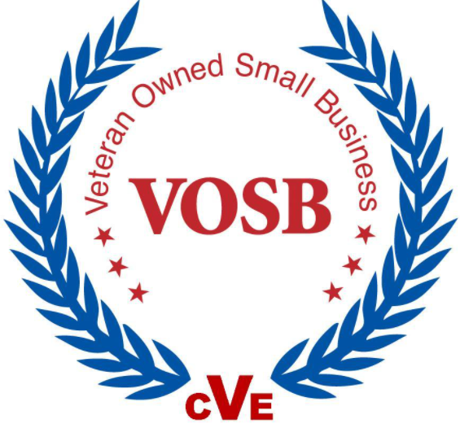
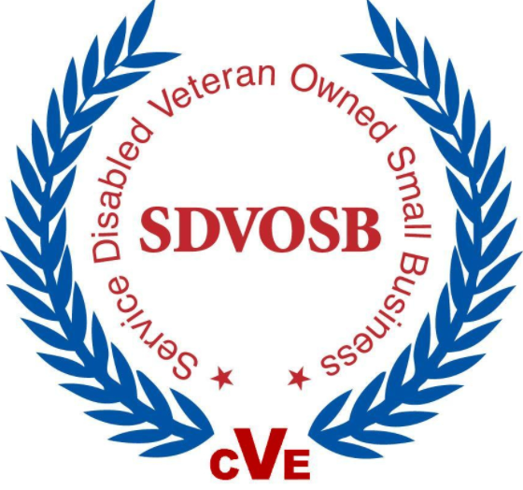
Veterans First Contracting Program
Veterans First Contracting Program (VETs First) created by 38 U.S.C. 8127 and 8128 and implemented by VA in 2009. This program gives preference to SDVOSBs and VOSBs.
Requirements to set aside:
Two or more
Certified, Qualified, Capable, Capacity
Expectation of Fair/Reasonable Pricing

Slide 12
FY23 Major Construction Opportunities - VHA Projects
Project Books:
Ashville, NC: Primary and Specialty Care Clinics
Charleston, SC: Bed Tower Replacement
Fresno, CA: Construct Clovis Health Care Center
Long Beach, CA: Spinal Cord Injury/Disease, Physical Medicine & Rehabilitation, and Prosthetics Center
Phoenix, AZ: Construct Bed Tower, Emergency Department, Inpatient Mental Health
San Antonio, TX: New Medical Center
St. Cloud, MN: Mental Health Residential Rehabilitation Treatment Program Building
Land Acquisitions:
Reno, NV: Due Diligence - New Campus
St. Louis (JC), MO - Land Acquisition of Liberty Plaza (two parcel)
Tampa, FL – Due Diligence – New Outpatient Clinic
Notes:
SPEAKER NOTES
Refer the audience to the Vendor Management website and QDR code at the end of the deck where they can find the Deck

Slide 13
FY23 Major Construction Opportunities - VHA Projects
Schematic Design Development:
West Los Angeles, CA: Phase H, Bldg 212 (SDs - RFP to SD)
Design Development:
West Los Angeles, CA: Phase H, Bldg 212
West Los Angeles, CA: New Critical Care Center.
Construction:
West Los Angeles, CA: Build New Critical Care Center
Biloxi, MS: Restoration Of Hospital/Consolidation of Gulfport (Ph X Renovate Building 1)
Dallas, TX: Long Term Spinal Cord Injury Building (Phase B)
Livermore, CA: Phase B - Stockton Community Based Outpatient Clinic - Offsite Road Improvement
Manhattan, NY: Medical Center - Flood Recovery
Manhattan, NY: Medical Center - 10 West Construction
Oklahoma City, OK - Construct Surgical Intensive Care Unit and Renovate Operating Rooms.
West Los Angeles, CA: Seismic Corrections Multiple Buildings - Building 212
CHIP IN Act
Tulsa, OK: Inpatient Facility

Slide 14
Interagency Agreement Opportunities
Schematic Design Development:
Roseburg, OR: Seismically Upgrade and Renovate Building 2 and Replace Building 1
Palo Alto, CA: Phase K - Ambulatory Care Center
Design Development:
Dallas, TX: Development/Tech Pkg: Clinical Expansion for Mental Health
Livermore, CA: Phase C East Bay CBOC / Phase C – Fremont
San Diego, CA: Phase C Building 11 Renovation
West Haven, CT:

Slide 15
Interagency Agreement Opportunities
Construction:
Alameda, CA: Phase 2 CBOC & CMO Construction Award
Canandaigua, NY: New Construction and Renovation
Canandaigua, NY: Phase 2 New Construction CLC, Dom and Demo Buildings
Livermore, CA: Realignment & Closure, Livermore Campus
Livermore, CA: Engineering Logistics Building (ELB)
Louisville, KY: New Medical Facility
Portland, OR: Phase 2 - DB B110, New Specialty Care and B111 New Garage
Portland, OR: Upgrade Building 100/101 for Seismic Retrofit and Renovation
San Francisco, CA: New Research Facility
West Los Angeles, CA: Build New Critical Care Tower

Slide 16
Interagency Agreement Opportunities
Design Build:
Dallas, TX: Development/Tech Pkg: Clinical Expansion for Mental Health
Gainesville, FL: Correct Noncompliant Surgical, Emergency, Pharmacy and Sterile Process
Perry Point, MD: New Community Living Center
Tampa, FL: Construct and Renovate SCI and Polytrauma Transitional Rehab Program Beds Building 38
West Haven, CT: New Surgical and Clinical Space Tower, Demolish Buildings 7, 8, 8.5 and 9
El Paso, TX: New Health Care Center
El Paso, TX: New Health Care Center - Concurrent Design/Site Development
Fort Harrison, MT: Phase 1 Central Utility Plant & Parking Garage

Slide 17
Interagency Agreement Opportunities
Seismic Design Build:
White City, OR: Replace Seismically Deficient Clinical Support Buildings with New Building 300
White City, OR: Replace Seismically Deficient Clinical Support Buildings with New Building 301
White City, OR: Seismically Mitigate and Expand Building 201 West for Outpatient Services
White City, OR: Renovate Seismically Deficient Building 202
Seismic Construction:
American Lake, WA - Seismic Upgrade and Renovation
San Francisco, CA – Seismic Mitigation
Seismic Plus Up:
American Lake, WA: Construction-Seismic Upgrade and Renovation of Building 7, Woman’s Health and Mental Health
American Lake, WA: Construction-Seismic Upgrade and Renovation of Building 8, Administration
American Lake, WA: Construction-Seismic Upgrade and Renovation of Building 9, Auditorium
American Lake, WA: Construction-Seismic Upgrade and Renovation of Building 111, Chapel

Slide 18
FY23 Major Construction Opportunities – NCA Projects
Land Acquisitions:
Albuquerque, NM: Land Acquisition for 200+ acres - Replace Santa Fe National Cemetery
Chattanooga, TN: Land Acquisition 200+ Acres
Western New York: Due Diligence to acquire 67 and 28 acres to support the Western New York Cemetery Expansion.
Design Development:
Chattanooga National Cemetery: Chattanooga National Cemetery
Ohio Western National Cemetery: Ohio Western National Cemetery Phase 4
Santa Fe National Cemetery: Albuquerque Replacement of Santa Fe National Cemetery - Alternate Site
Construction:
Ft Logan National Cemetery Gravesite Expansion: Ph 1
Western New York National Cemetery: Phase C Maintenance Complex

Slide 19
Seismic – VHA Opportunities
Project Books:
Columbia, SC: Correct Building 9 Seismic Deficiencies
North Little Rock, AR: Correct Seismic Deficiencies in Building 66 - NLR
North Little Rock, AR: Correct Seismic and Structural Deficiencies Building 69
Roseburg, OR: Seismic Retrofit Bldg 11 Laundry
Roseburg, OR: Seismic Retrofit Bldg 13 Warehouse
Roseburg, OR: Seismic Retrofit Bldg 16 Chapel and Auditorium
Long Beach, CA: Seismic Retrofit of Building 7
Long Beach, CA: Seismic Retrofit of Building 2
Long Beach, CA: Provide Seismic Bracing for Building 1
Design:
Marion, IL- FCA - Correct Seismic Deficiencies at Building 14
Albuquerque, NM: DBB to 35% Schematic Design - Seismically Mitigate Research-Rehabilitation Building, Bldg 11
Albuquerque, NM: DBB to Construction Document - Seismically Mitigate Research-Rehabilitation Building, Bldg 11

Slide 20
Seismic – VHA Opportunities
Design Build:
Menlo Park, CA: Solicitation for DB contract-Retrofit Seismically Deficient B114, Boiler House
Palo Alto, CA: Solicitation for DB contract-Retrofit Seismically Deficient Building 6
Palo Alto, CA: Solicitation for DB contract-Seismic Retrofit Seismically Deficient Building 40, Boiler House
Palo Alto, CA: Solicitation for DB contract - Renovate Seismically Deficient Building 7, SCI/Rehab
Sepulveda, CA: Award RFP Level 1 SD1 Replace Seismically Deficient Bldg 47 and 103, with a New Building
Construction:
Reno, NV - Replace Seismically Deficient Boiler Plant, Bldg 8

Slide 21
Plus Up Seismic – VHA Opportunities
Project Books:
Seattle, WA: Replace Seismically Deficient Research Buildings with New Building, Bldgs 8 and 11
Columbia, MO: Correct Seismic Deficiencies-Ph.1, Bldg 1
Design:
Poplar Bluff, MO: Correct Seismic Deficiencies Bldg 1
Walla Walla, WA: Seismically Mitigate and Renovation of Building 75
Walla Walla, WA: Seismically Mitigate Building 77
Walla Walla, WA: Seismically Mitigate Admin and Clinical Support Building, Bldg 68
Albuquerque, NM: DBB to 35% Schematic Design - Seismically Mitigate Psychiatry Building, Bldg 1
Albuquerque, NM: DBB to 35% Schematic Design - Seismically Mitigate Psychiatry-RCU Building, Bldg 3
Albuquerque, NM: DBB to 35% Schematic Design - Seismically Mitigate Building 2
Albuquerque, NM: DBB to 35% Schematic Design - Seismically Mitigate Building 4
Albuquerque, NM: DBB to 35% Schematic Design - Seismically Mitigate Research Building, Bldg 10

Slide 22
Plus Up Seismic – VHA Opportunities
Design:
Albuquerque, NM: DBB to 35% Schematic Design - Seismically Mitigate Research Building, Bldg 12
Albuquerque, NM: DBB to 35% Schematic Design - Seismically Mitigate Non-Institutional Care Building, Bldg 15
Albuquerque, NM: DBB to Construction Document - Seismically Mitigate Psychiatry Building, Bldg 1
Albuquerque, NM: DBB to Construction Document - Seismically Mitigate Psychiatry-RCU Building, Bldg 3
Albuquerque, NM: DBB to Construction Document - Seismically Mitigate Building 2
Albuquerque, NM: DBB to Construction Document - Seismically Mitigate Building 4
Albuquerque, NM: DBB to Construction Document - Seismically Mitigate Research Building, Bldg 10
Albuquerque, NM: DBB to Construction Document - Seismically Mitigate Research Building, Bldg 12
Albuquerque, NM: DBB to Construction Document - Seismically Mitigate Non-Institutional Care Building, Bldg 15
Construction:
Leavenworth: Correct Seismic Deficiencies for Building 41
Marion, IL: Correct Seismic Deficiencies B13

Slide 23
Service Opportunities
Cost Estimating IDIQ
Veteran Facility Transformation and Healthcare Enhancement (formerly known as MASHO)
CFM Program Support
Financial/Claims Support

Slide 24
FY24 Super Construction Opportunities
Land Acquisitions:
Dallas, TX: Clinical Expansion for Mental Health, Expansion of Parking Facilities, and Land Acquisition
Schematic Design Development:
San Juan, PR: Seismic Corrections Building 1, New Admin Building, Expansion of Outpatient Clinic and Parking Structure
San Diego, CA: Spinal Cord Injury and Seismic Building 11
Construction:
American Lake, WA: Construction of New Specialty Care Building 201, Renovation of Building 19 and Expansion of Parking Facilities
San Francisco, CA: New Research Facility, Parking Structure, and Demolition
El Paso, TX: Construct New Health Care Center and Utility Plant

Slide 25
FY24 Super Construction Opportunities
Design Development:
Perry Point, MD: Replacement Community Living Center (CLC) and Parking
St. Louis, MO: Replace Bed Tower, Clinical Building Expansion, Consolidated Administrative Building and Warehouse, Utility Plant and Parking Garages
West Haven, CT: New Surgical and Clinical Space Tower Renovation of Buildings 1 and 2 Demolition
Portland, OR: Upgrade Buildings 100 and 101 for Seismic Retrofit and Renovation. Roadway and Site Improvements, New Specialty Care Facility, Demolition and Expansion of Parking Facilities
Construction Documents:
St Louis (JC), MO: Replace Bed Tower, Clinical Bldg Expansion & Parking Garage
Construction:
St. Louis, MO: Jefferson Barracks National Cementary Phase I Gravesite Expansion
Takoma, WA: Phase 3 Gravesite Development

Slide 26
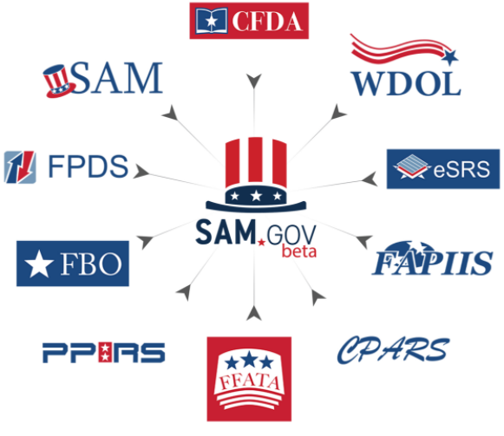
Resource Opportunities
Market Research - Meeting the challenges (Partnership and Participation)
External research at https://sam.gov (System for Award Management) for:
Sources Sought
NAICS, Agency, Location, Set-Aside
Industry Days
Site Visits
Previous Contracts (Government-wide)
Contact a knowledgeable Persons in Government
U.S. Small Business Administration Contracting Guide
https://www.sba.gov/federal-contracting
CFM Small Business Liaisons (SBLs)
https://www.va.gov/osdbu/about/contacts.asp#sbl
Angeleque Batkins (Eastern Region)
Andrea Morris (Central Region)
George Williams (Western Region)
David Bullerwell (National Region)
Tiffany Rivers (AECCPS)

Slide 27
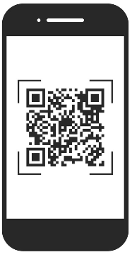
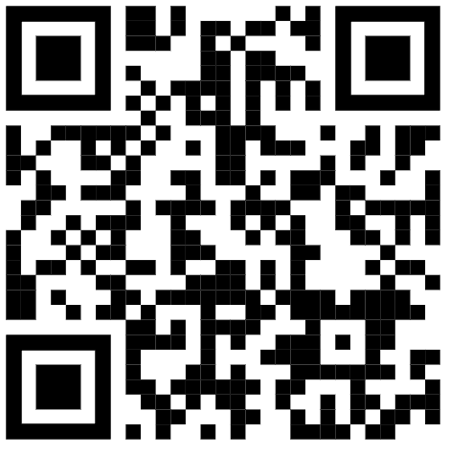
CFM Vendor Management
Check out our website and look at our Vendor Management
if you are interested in:
Resources on CPARS training
President’s Budget Request for VA
VA Forecast of Contracting Opportunities
Pathfinders – Interested in doing business with CFM
Find resources with the
Office of Small and Disadvantaged Business Utilization (OSDBU)
SCAN ME

Slide 28
U.S. Department of Veterans Affairs Office of Small and Disadvantaged Business Utilization Resources
Office of Small and Disadvantaged Business Utilization
www.va.gov/osdbu
Women Veteran-Owned Small Business Initiative
https://www.va.gov/osdbu/WVOSBI.asp
Upcoming Virtual Business Opportunity Sessions for a variety of business lines
www.vetbiz.va.gov/events
Small Business Training Resources
https://www.va.gov/osdbu/outreach/soc/training.asp
Upcoming Training Webinars
https://www.va.gov/osdbu/outreach/soc/webinar-schedules.asp
Acquisition Support
https://www.va.gov/osdbu/acquisition/index.asp
Upcoming Small Business Outreach Events hosted by Other Government Agencies
https://hallways.cap.gsa.gov/app/#/gateway/federal-osdbu-directors-interagency-council/79871/events-calendar
Direct Access Program (DAP) – Quarterly one on one with CFM Representative.
https://www.va.gov/osdbu/outreach/dap/index.asp

